Slide 1
Project 1:
Collaborators:
Andreas Hill
Layla Abdul Sater
Osmar Eduardo Luna Lucatero
Priscila Glienke
Kristian Rafuse

Slide 2
Table of Contents:
Introduction.
Data Source and Questions.
Analysis.
Conclusion.
Comments.
Questions?

Slide 3
Introduction:
As consumers continue to suffer with financial uncertainty caused by the coming recession, budgeting apps have become a popular way to track expenses and save money.
Canadian consumers are drowning in debt since it has risen to $2.32 trillion, with an average debt load of approximately $21,183—excluding mortgages. These numbers represent an increase of 8.2% over last year, and 6.4% between the first and second quarters of 2022, and household debt-to-income ratio is 167.8%.
For the reasons listed above we decided to study the Canadian Household Finance Market by analyzing the income, expenses, savings, debts and some of the relevant stocks from the Canadian stock market.
Reference:
State of Mobile 2022 - data.ai /Central government debt (statcan.gc.ca)

Slide 4
Data Source & Questions:
Distributions of household economic accounts, income, consumption and saving, Canada, provinces and territories, annual (x 1,000,000)
https://www150.statcan.gc.ca/t1/tbl1/en/tv.action?pid=3610058801
Credit liabilities of households (x 1,000,000)
https://www150.statcan.gc.ca/t1/tbl1/en/tv.action?pid=3610063901
What is the range of average monthly income for Canadians and how common are outliers in the data?
What is the average monthly spending of Canadians and how does it vary across different categories?
What is the trend in disposable income for Canadian households across quintiles over the past two years? How has the distribution of net worth across quintiles changed over this period, and is there a correlation between changes in disposable income and changes in net worth?
What is the trend in household net savings compared to employee income across Canada in the last five years? Is there a noticeable difference in the proportion of household net savings to employee income between different regions or income levels in Canada?
What is the breakdown of mortgage debt in Canada by category, including chartered banks, non-banks, and non-residential mortgages? How has the distribution of mortgage debt changed over time for each category?)
What is the comparison of household net savings between different Canadian provinces over the past five years? Is there a significant difference in the level of household net savings between different provinces? What does this tell us about household financial behavior across the country?

Slide 5
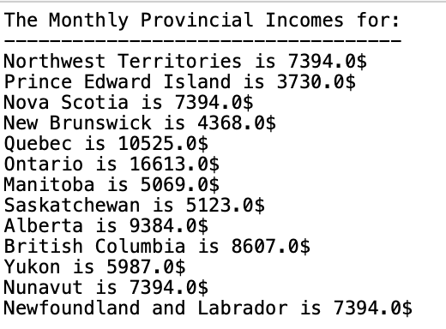
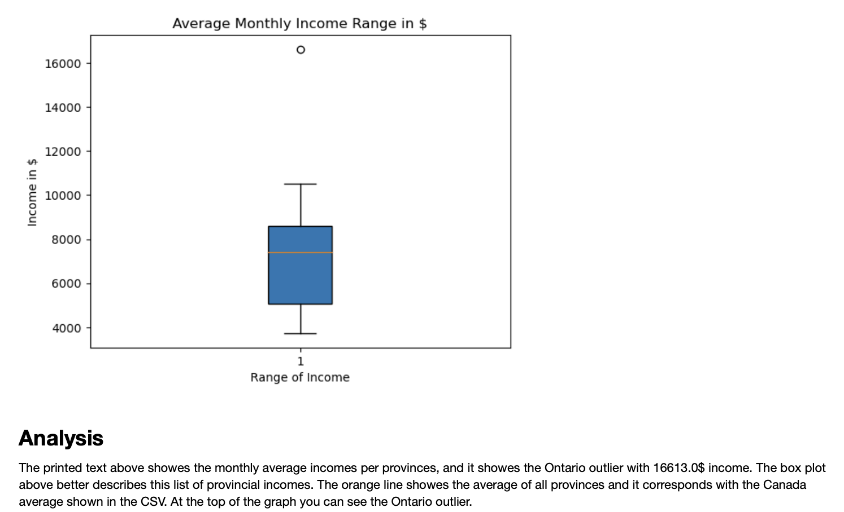

Slide 6
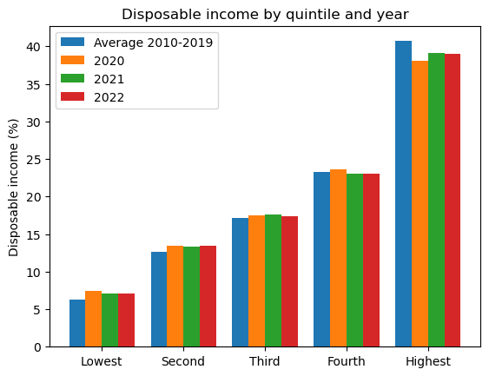
The latest release of estimates from the Distributions of Household Economic Accounts reveals that in the second quarter, income inequality reached an all-time high since the beginning of the COVID-19 pandemic, with average disposable income declining for households with the lowest income (-5.7%) and the youngest age group (-2.6%). Inflationary pressures had a negative impact on net saving, regardless of their demographic or economic characteristics, as cost-of-living increases outweighed growth in disposable income. Income gap highest since start of pandemic The gap in the share of disposable income between households in the two highest income quintiles and the two lowest income quintiles reached 46.3% in the second quarter, up 0.2 percentage points, the highest it has been since the beginning of the pandemic.

Slide 7
Through the analysis of data provided by Statistics Canada, we can gain insights into the spending habits of Canadian households over the past decade, from 2012 to 2022. This initial analysis was exploratory in nature, aiming to provide insight into Canadian spending. Simply put: “What are Canadians spending their money on?”. Looking at this data can provide Canadians with useful insights into how they spend their money and how their spending habits compare to those of other households in Canada. By understanding the share of expenditures by category, for example, Canadians can get a sense of where their money is going and potentially identify areas where they can cut back on spending or find more cost-effective solutions.

Slide 8
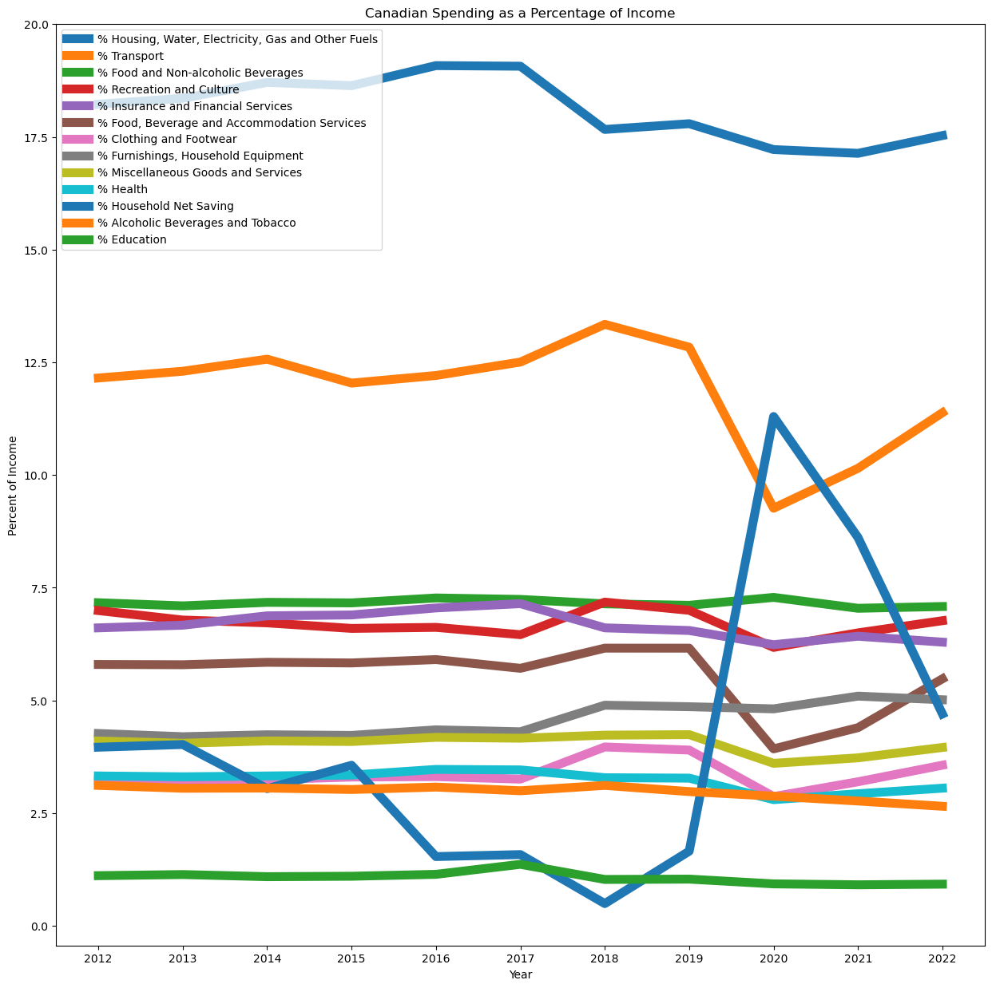

Slide 9
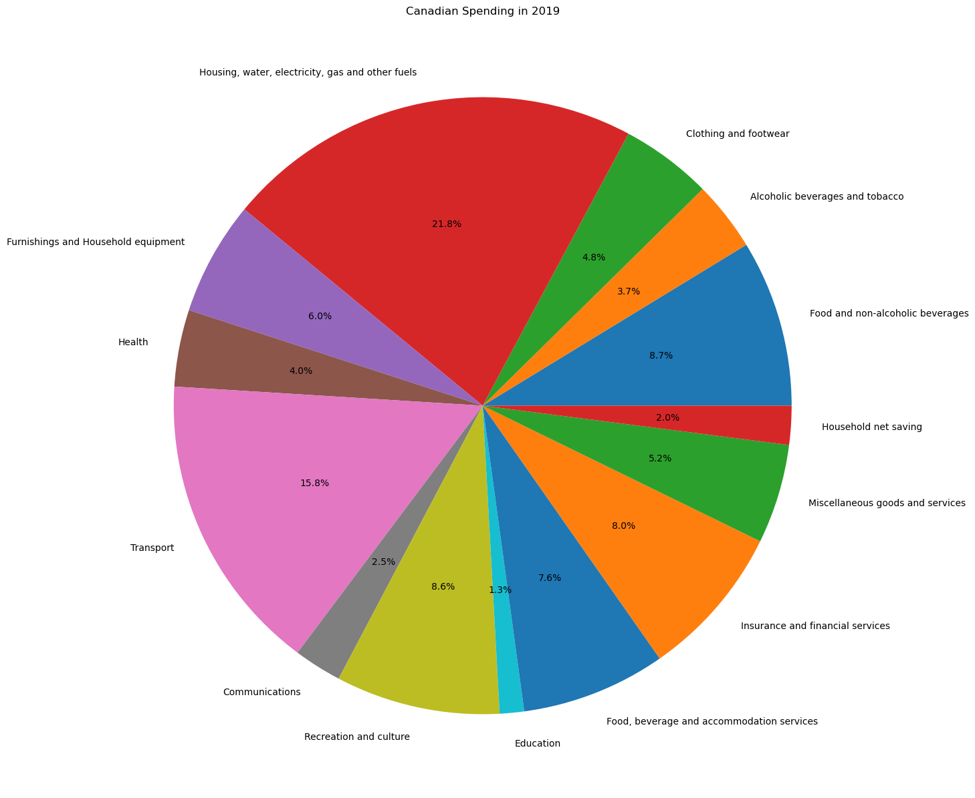

Slide 10
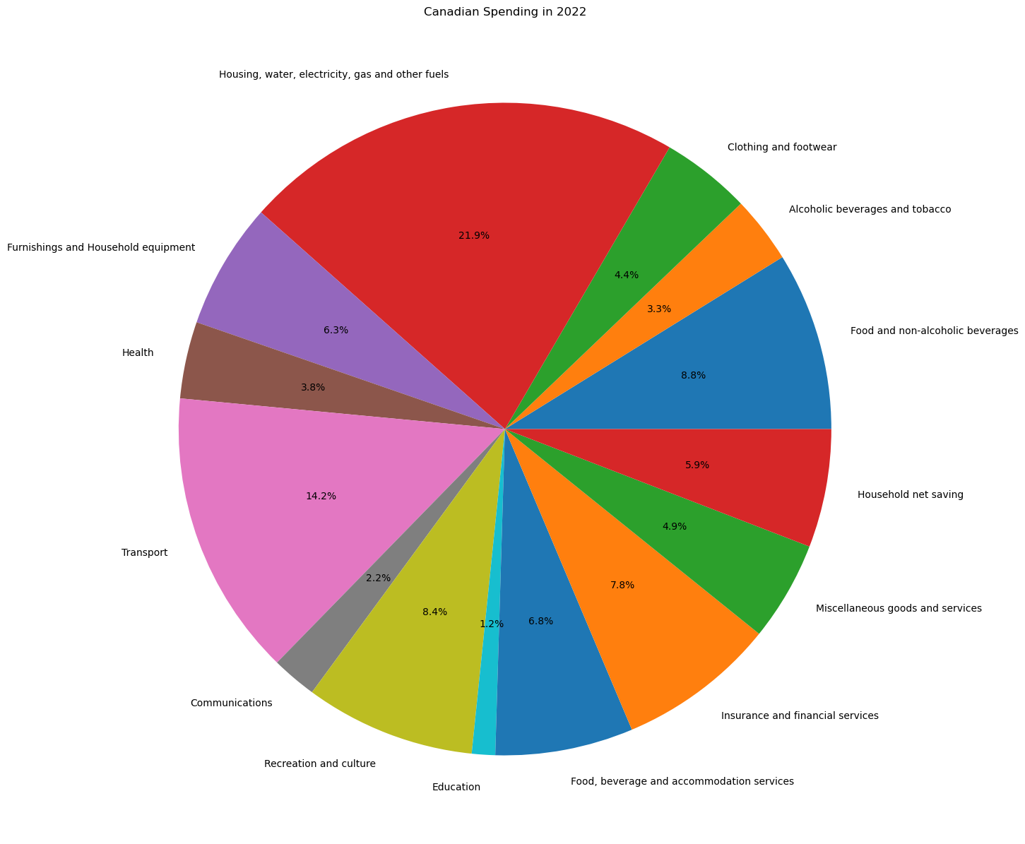

Slide 11
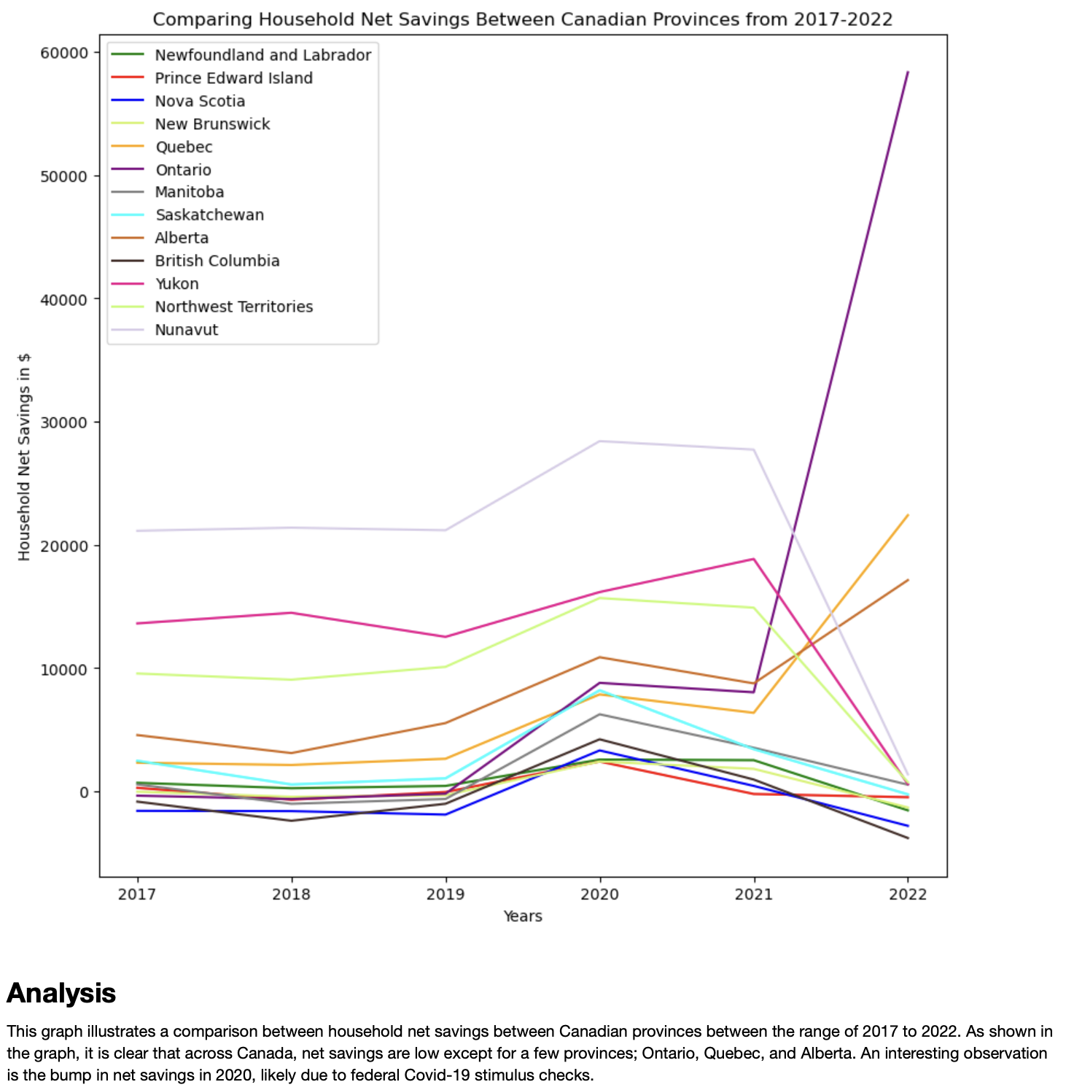

Slide 12
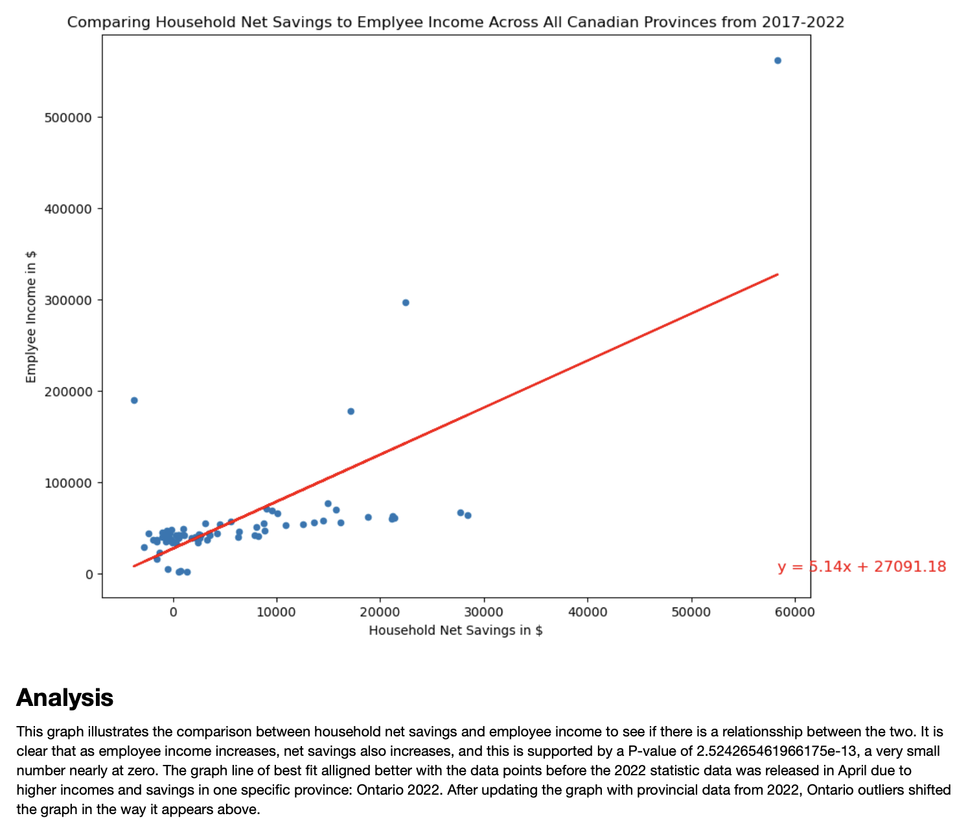

Slide 13
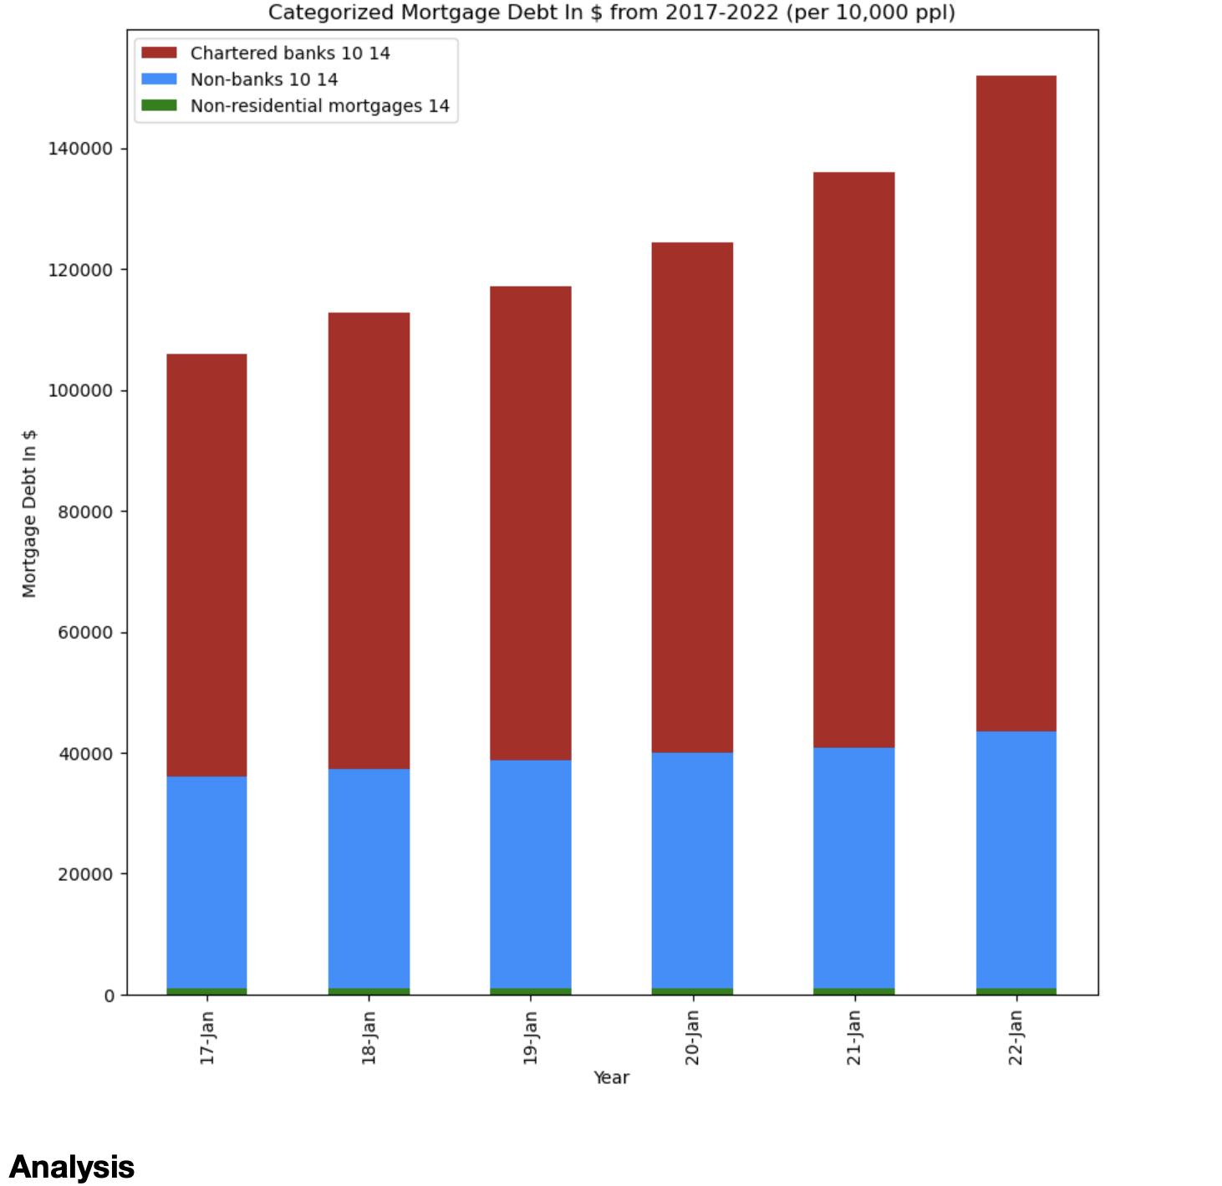
Chartered banks supply majority of non‑mortgage loans, unchanged by pandemic As household non‑mortgage debt steadily grew over the last 30 years, continued industry consolidation increased the market share of major banks relative to other lending sectors, leading to a growing share of financing originating from chartered banks. As home valuations steadily rose, the rise in popularity of Home Equity Lines Of Credit (HELOCs) through the mid‑2000s further exacerbated the divide, as banks were able to tap into a much larger share of Canadian household mortgages against which borrowers could unlock additional funds. Perhaps emboldened by the strength of the Canadian housing market over the last decade and steadily declining interest rates, HELOCs grew to become the product of choice for household non‑mortgage borrowing. Despite changes in borrowing preferences that have resulted from the pandemic, the market share between banks and non‑banks continues to remain relatively unchanged since 2011, with chartered banks holding 74% of non‑mortgage debt

Slide 14
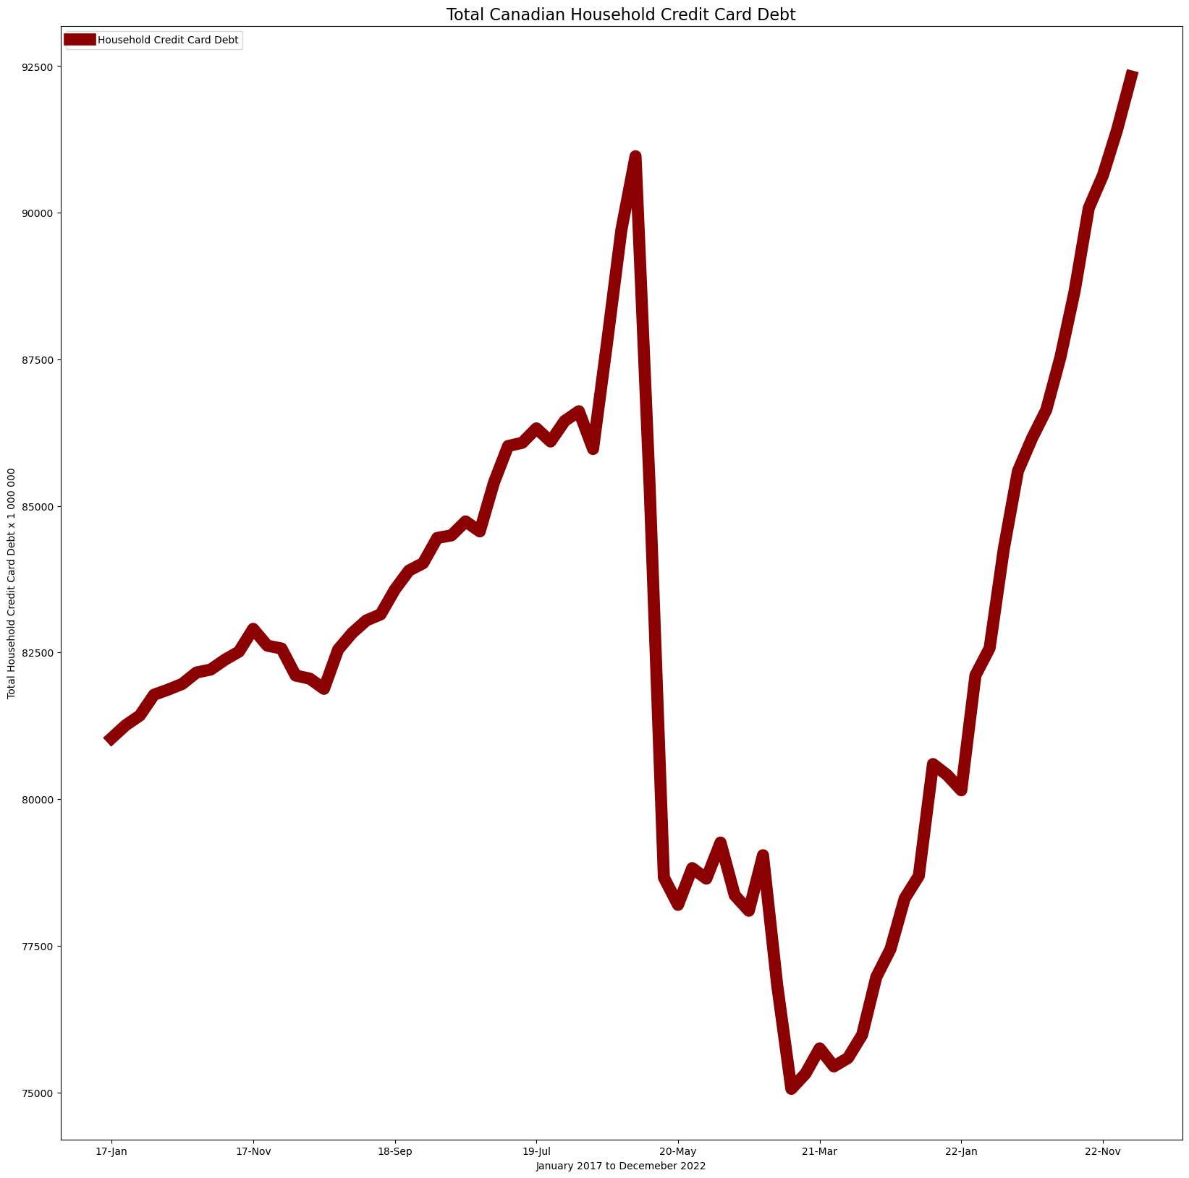
As lockdowns remained in effect, banks extended temporary credit relief to their customers through the summer, and as a result the average outstanding balance weighted APRs (Annualized Percentage Rate) for credit cards declined from their February highs. However, these measures had been largely curtailed, and average effective rates returned to their pre‑pandemic levels. With interest at historic lows, and credit card APRs on the rise, the implicit cost of using credit cards reached a record level as measured by the difference between the costs of funds and the rates being charged. While one might conclude that average credit card rates rose in response to a shift in outstanding balances from higher credit rated borrowers to lower, the reality is that those with lower scores repaid their debt at a faster rate than those with higher scores throughout the pandemic.

Slide 15
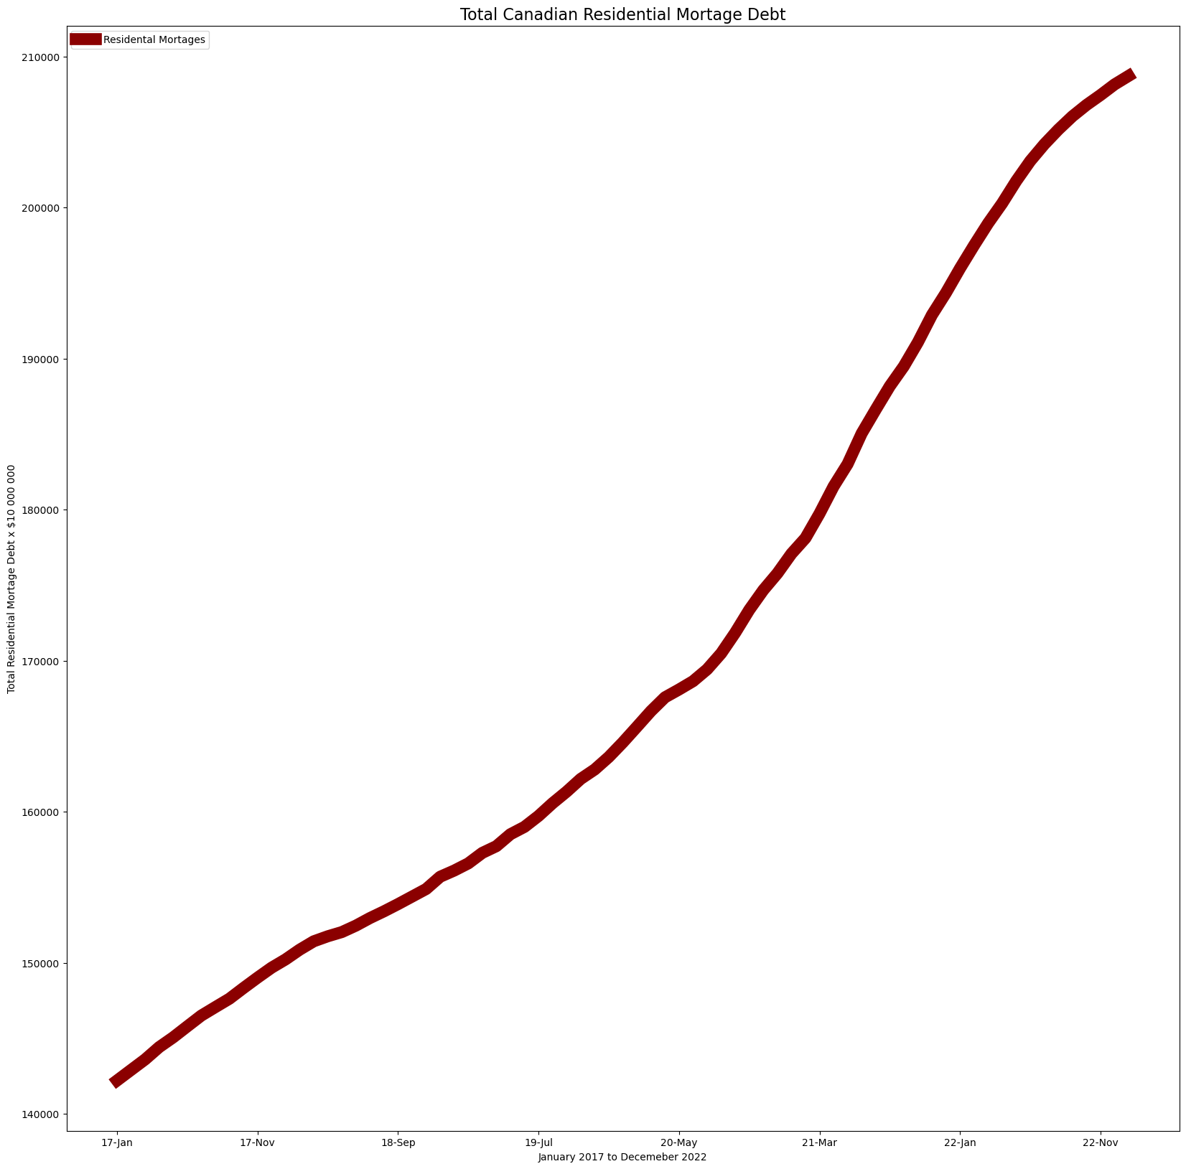
According to the data found on the Statistics Canada website, the total Canadian residential mortgage debt has continued to increase over the past few years. In 2017, the total residential mortgage debt was $1.42 trillion, which increased to $1.67 trillion by 2020, a significant increase of 17.6% over three years. In 2020, the total residential mortgage debt was $1.67 trillion, up from $1.62 trillion in 2019. This has made it more difficult for Canadians to afford homes, leading many to take on larger mortgages. While the increase in residential mortgage debt may be a cause for concern for some, it is important to note that mortgage debt is generally considered to be "good" debt, as it is backed by an asset that typically increases in value over time. However, it is important for Canadians to manage their mortgage debt carefully, ensuring that they are able to make their mortgage payments on time and not overextend themselves financially.

Slide 16
Comments:
In the slides below, there’s extras studies on Ontario’s income, spending and saving market and the Canadian imperial stock market evolution as well as Canadian natural resources and Air Canada and the impact of Covid 19.

Slide 17
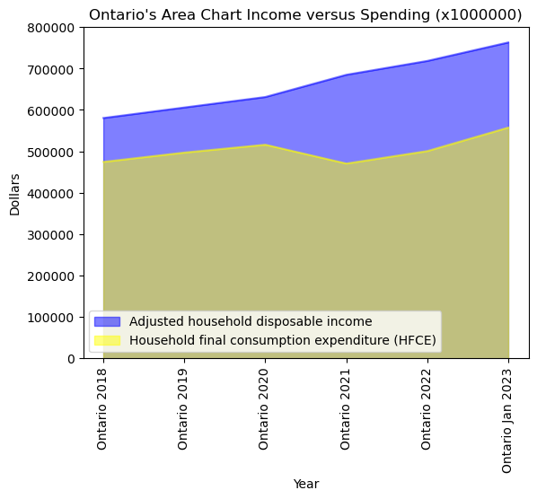
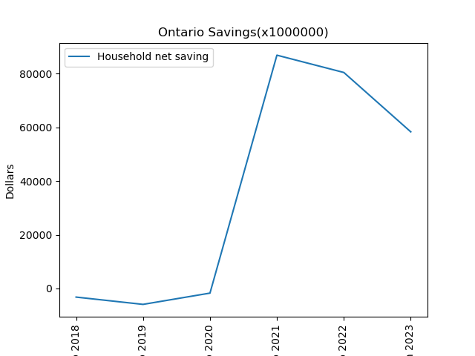
Ontario saving was in the negative before 2019 and reached its peak in 2021 and its back to decline.
We can see how the expenses dropped during pandemic (2020-2021) and back to rise.

Slide 18
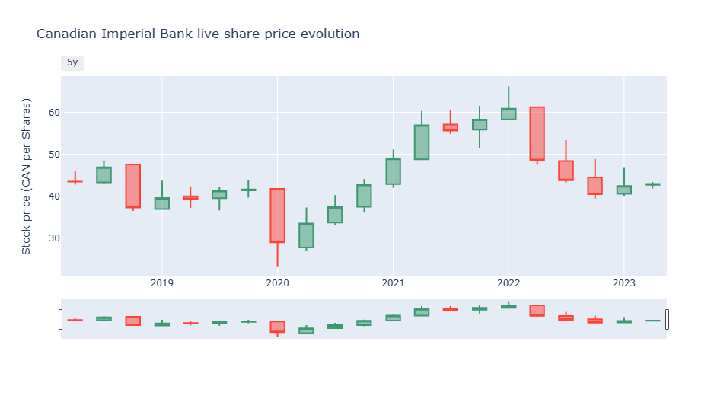

Slide 19
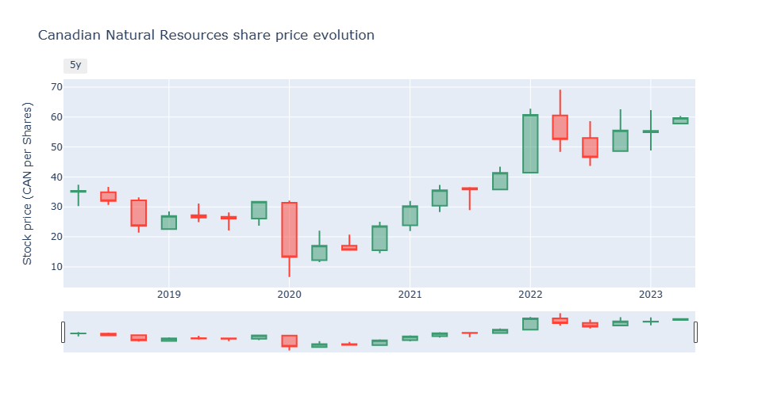

Slide 20
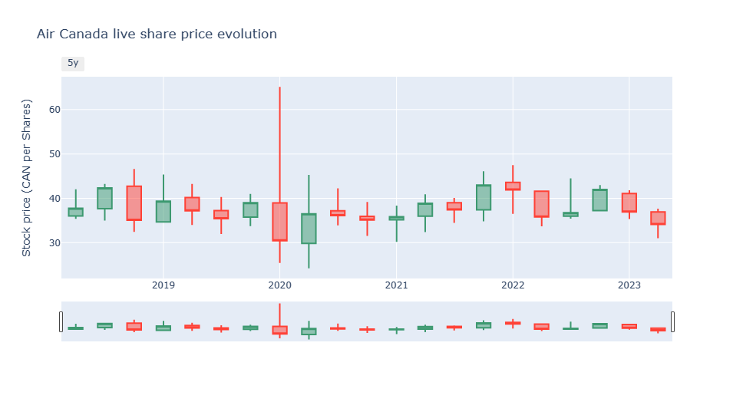

Slide 21
Conclusion:
As per our analysis , it is important to note that overall Canadian debt levels, particularly mortgage and credit card debt, have also increased during this time period. This highlights the need for Canadians to carefully manage their spending and debt levels, particularly in the areas of housing and credit card usage. Lastly, the data on Canadian household expenditures from 2012 to 2022 reveals several important trends in Canadian spending habits. While there has been an increase in the percentage of income spent on housing-related expenses, Canadians have also managed to increase their savings rate. However, the rise in overall debt levels, particularly in mortgage and credit card debt, suggests the need for Canadians to carefully manage their finances and debt levels.
In addition to the rising cost of living, Canadians are also facing other financial pressures. For example, the Bank of Canada recently raised interest rates for the first time since the pandemic began, which will make it more expensive for Canadians to borrow money. This, combined with high levels of debt, and increasing amounts of mortgage debt, could lead to a debt spiral for some Canadians, particularly those with lower incomes.
Overall, the increase in Canadian credit card debt since March 2021 highlights the ongoing financial challenges facing many Canadians due to rising costs. While the government has provided support through programs such as the Canada Emergency Response Benefit (CERB), many Canadians are still struggling to make ends meet, and will likely continue to do so until the economy fully recovers.

Slide 22
Questions?

